Slide 1

2026 Kickoff Meeting

Slide 2
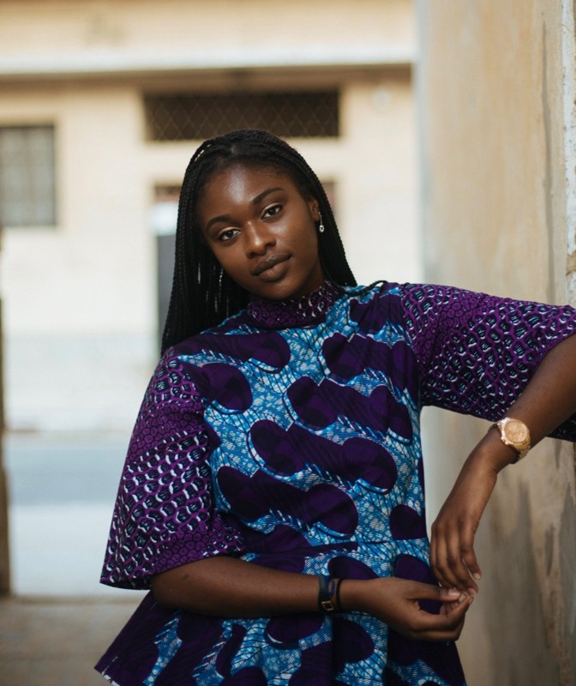
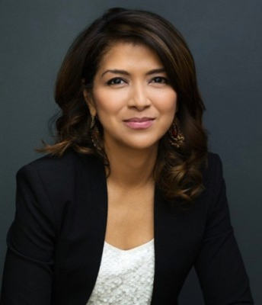
Introductions
Penda Sarr
Program Manager, Global Network
Leah Lizarondo
Vice President, Global Network

Slide 3
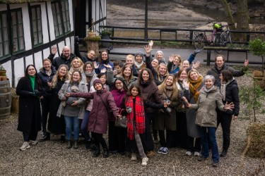
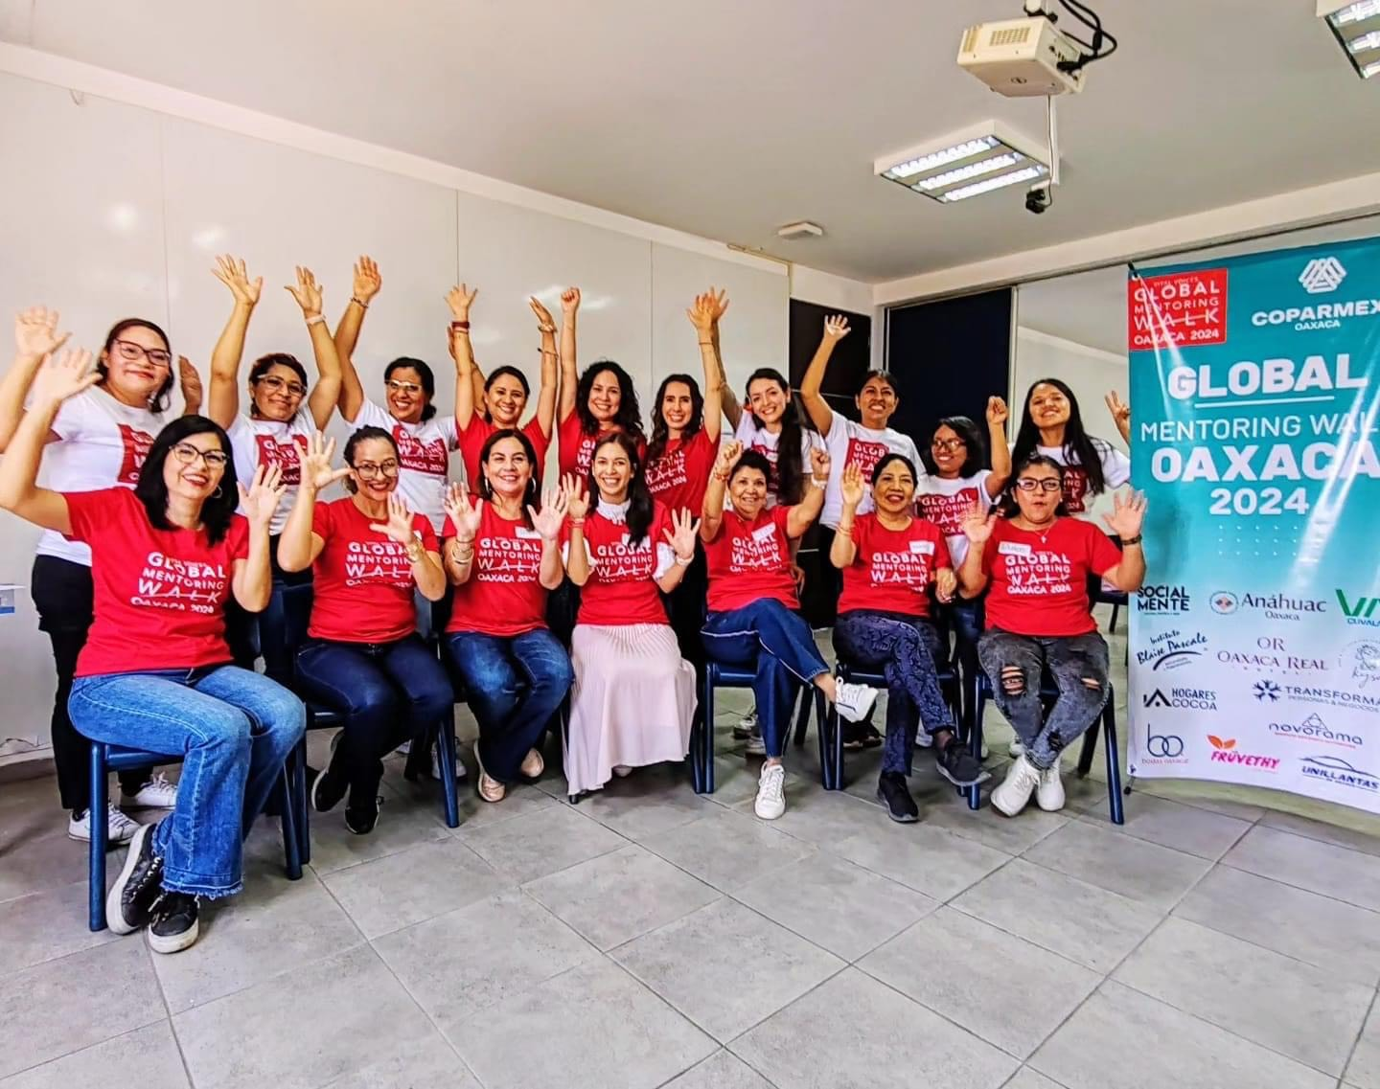
Agenda
Overview of the GMWs
History of the Mentoring Walks
Why Mentoring Walks
Flag Bearer Toolkit
Event Components
New this year! Record your miles
Next Steps
Reminders
Q&A
Notes:
During today’s webinar, I will be going over the history of the mentoring walks, why we promote mentoring, and what resources you can find in the Flag Bearer toolkit. Then Rumana will be sharing some tips on how to fundraise for your Global Mentoring Walk.

Slide 4
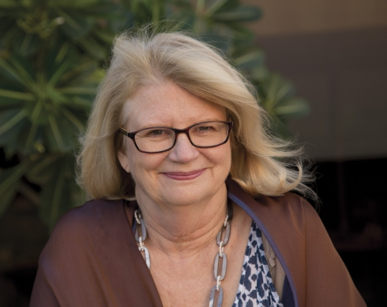
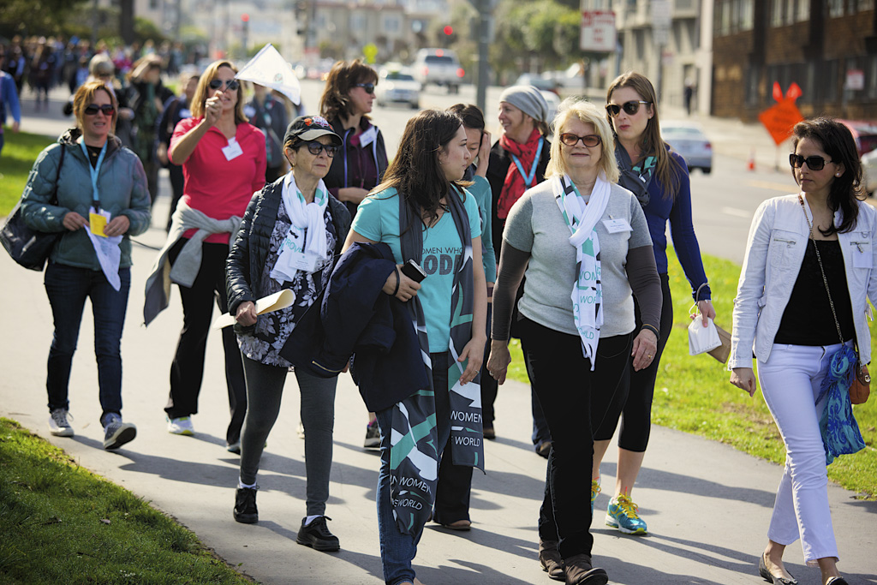
History of the Global Mentoring Walks
Notes:
We are excited that we continue to have more and more women leaders join us for the Global Mentoring Walks. What is now a global movement began with one women’s effort to share her knowledge and experience with emerging women leaders. Gerry Laybourne is an American media entrepreneur who for years was receiving requests from women for informational meetings and advice. The reality of her busy schedule meant that she simply did not have time to accommodate all of these meeting requests. Rather than exclude emerging women, she invited them to join her daily morning walk through central park. During this time, emerging women asked questions, sought feedback, and developed mentoring relationships amongst themselves and with Gerry. More and more women began joining these walks and Gerry saw that something special was happening and began launching walks throughout the United States in partnership with Vital Voices.

Slide 5
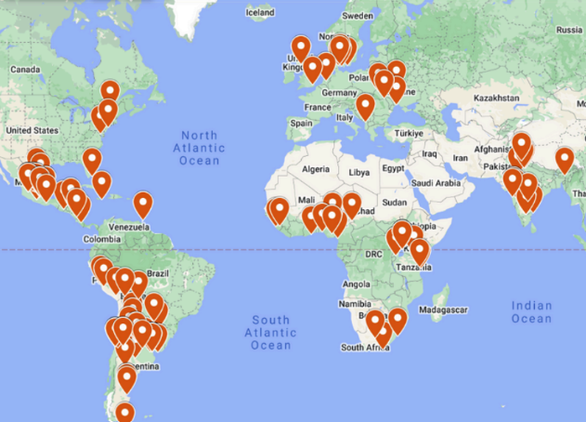
2025 Global Mentoring Walks
136 Walks
37 Countries
11,780 Attendees
Notes:
Then in 2008, Gerry was participating in a Vital Voices program as a mentor and shared her story. Hearing the innovative approach, women of the network decided that this was something they could replicate in their communities. So the single mentoring walk in central park became a global movement.

Slide 6
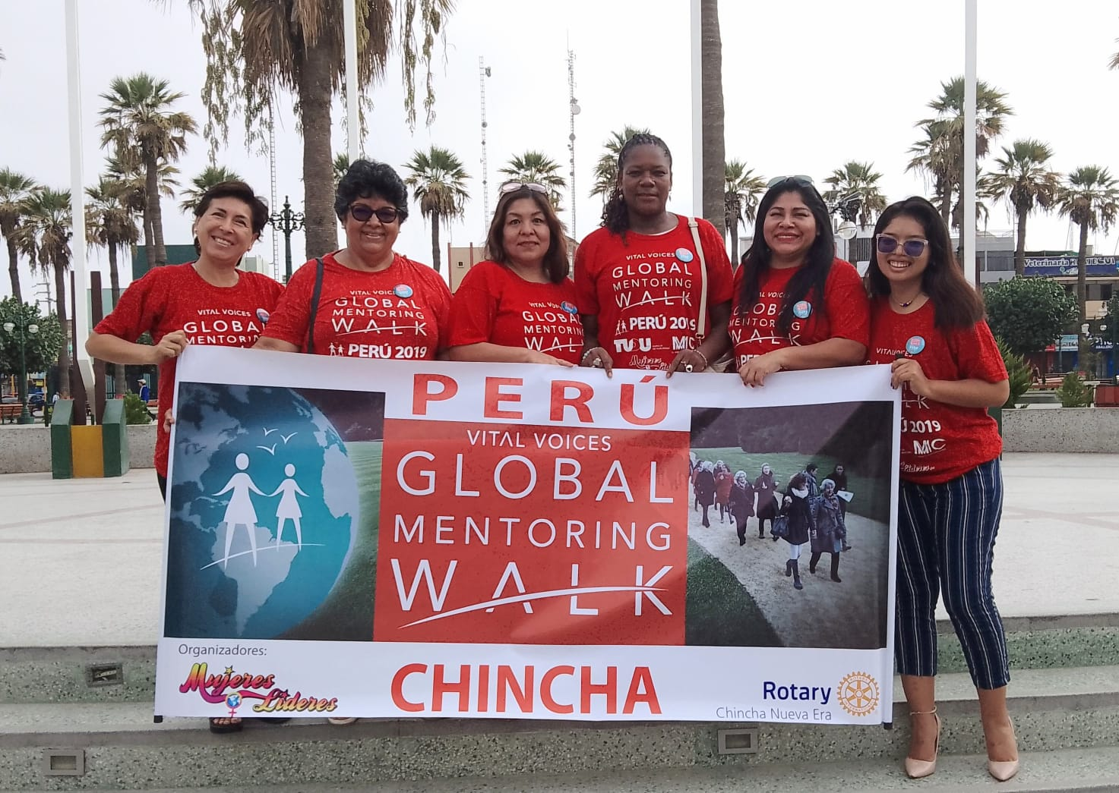
2008-2025 Stats
60 countries
1,316 walks
142,825 participants!

Slide 7
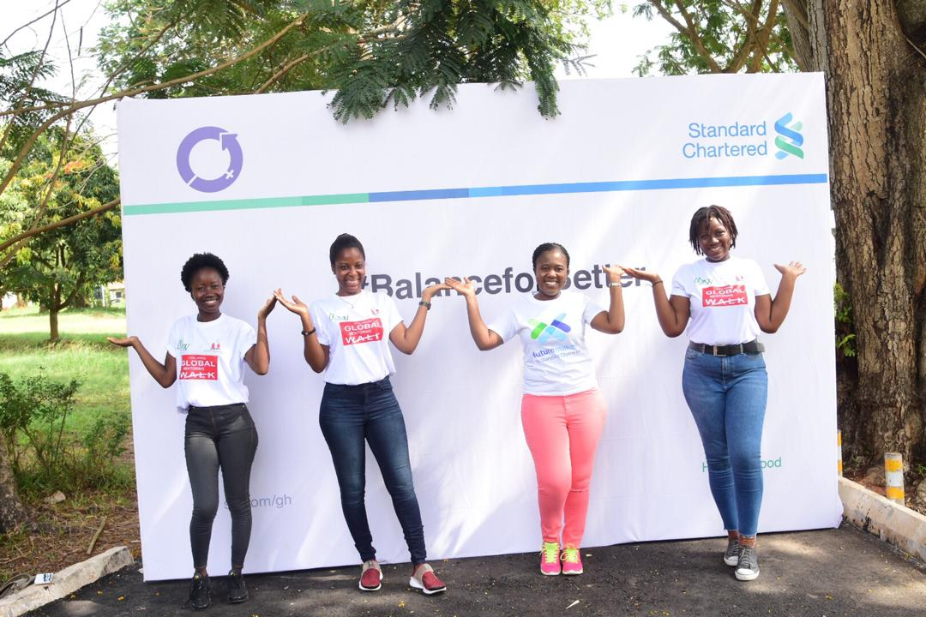
2025
THANK YOU ALL for making a difference in your community!!

Slide 8
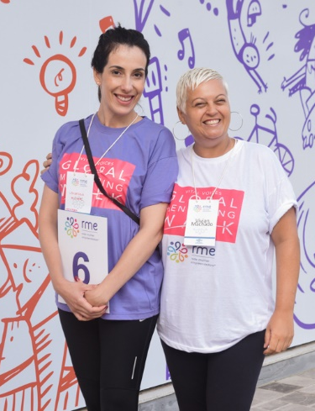
Why Global Mentoring Walks?
Brings together Vital Voices Global Leadership Network
This is OUR Collective Action for women's leadership!
Highlight the importance of women’s leadership
Accelerate the impact of women leaders through mentoring and community
Pay it forward

Slide 9
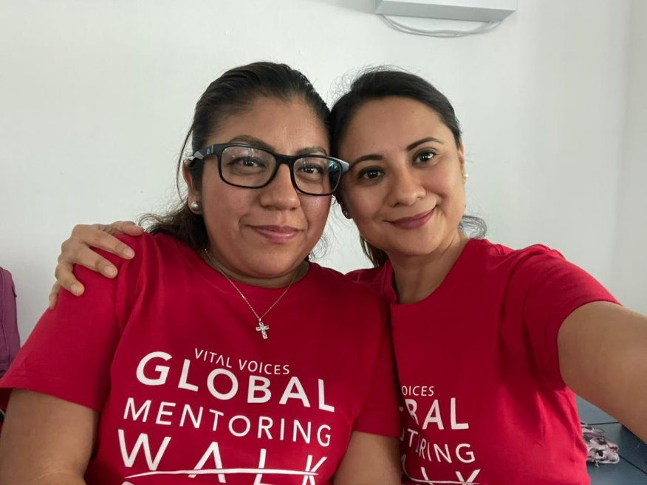
2026 Theme
Your Leadership Journey
Reflect on your path: the ideas you are nurturing, the risks you have taken, the force you are becoming, and the ways you are already lifting others

Slide 10
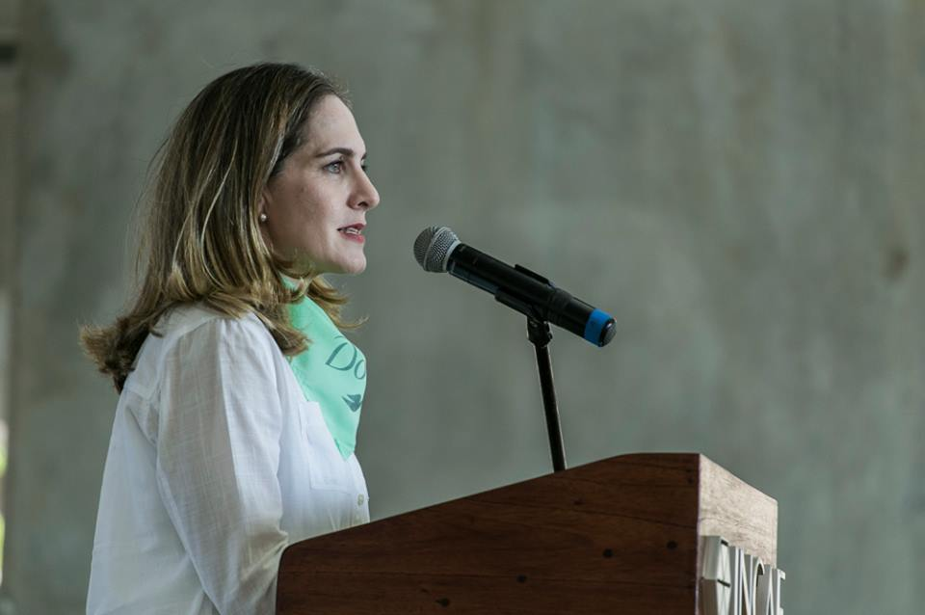
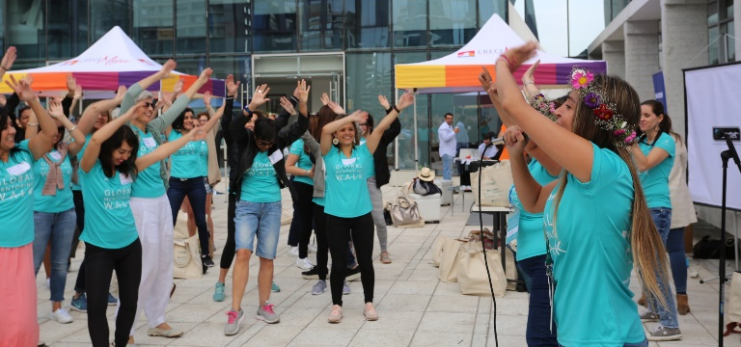
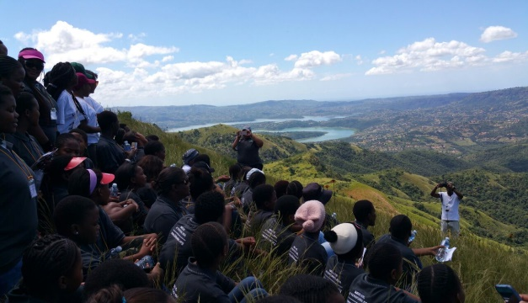
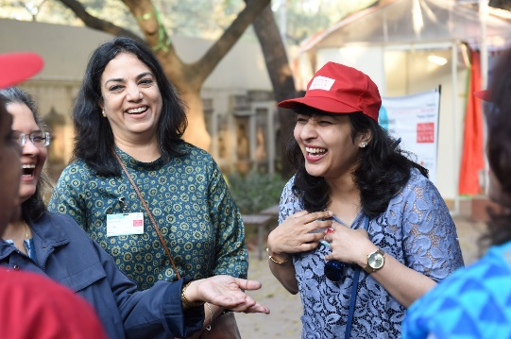
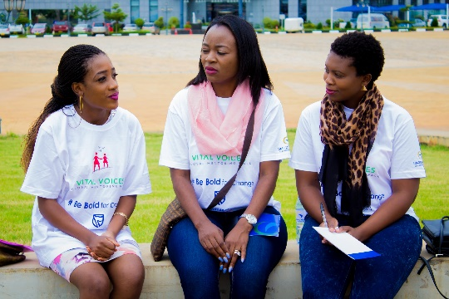
Flag Bearer Toolkit
Mentoring best practices (mentor/mentee selection, how to facilitate strong mentoring relationships)
Walk planning checklists
Fundraising tips
Networking exercises
Find the Toolkit on the 2026 GMW Hub Group

Slide 11
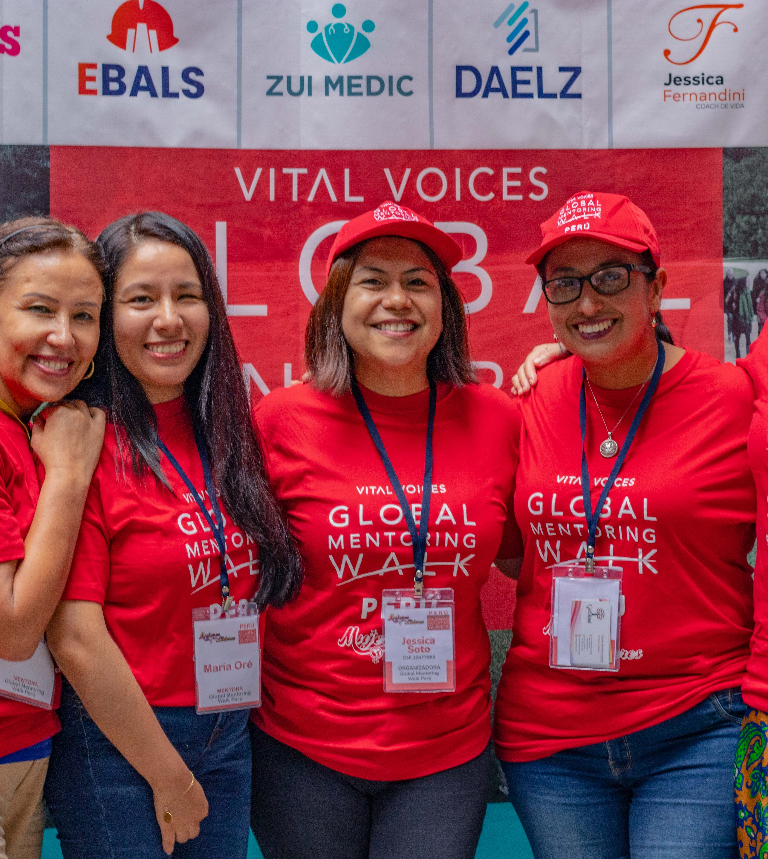
Event Components
The Walk
Speakers & Panels
Trainings or Workshops
Highlighting Community & Organization Partnerships
Notes:
Drop in the chat popular trainings or workshops or creative activities you hosted to share with others on the call

Slide 12
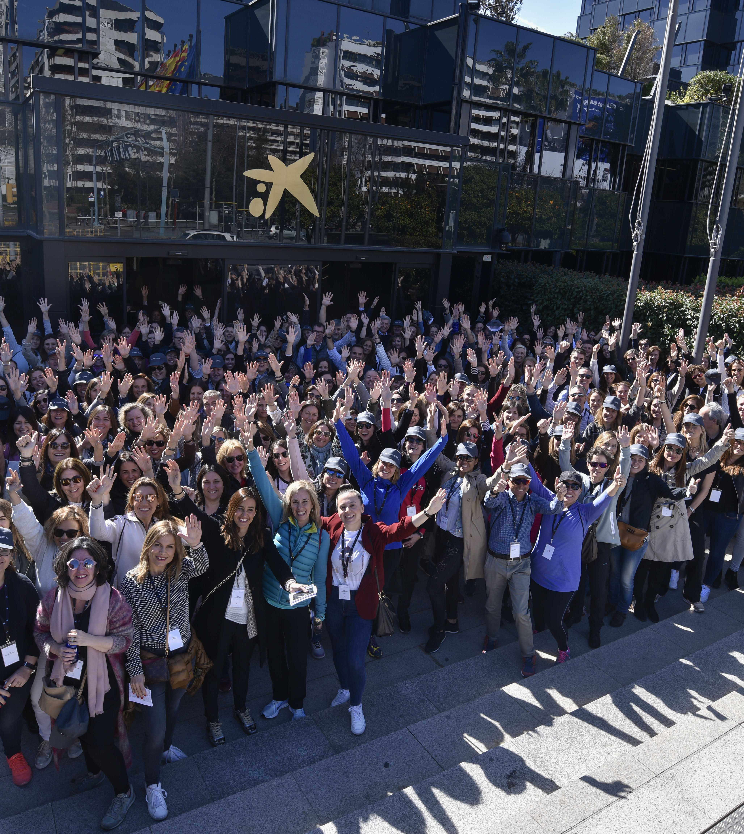
NEW THIS YEAR! RECORD YOUR MILES!
Please record the DISTANCE from the starting point of your walk to the end point of your walk
We would like to talk about the GMW in these terms this year.
This will be asked in the registration form
Notes:
Drop in the chat popular trainings or workshops or creative activities you hosted to share with others on the call

Slide 13

Next Steps
GMW Webinar 1: February 9th at 9 AM EST
Join the Hub 2026 GMW grouphttps://community.vitalvoices.org/c/welcome-global-mentoring-walk/
Register to be a Flag Bearer – we will send in an email with the link to the registration form
Mark your calendars for March 7 , 2026 (on or around this date) and start planning!
Questions: reach out to globalnetwork@vitalvoices.org
Penda pendas@vitalvoices.org
Leah leahl@vitalvoices.org

Slide 14
Reminders
Combining efforts in overlapping cities
Register all of your walks
If doing virtual, be sure to let us know which cities are included
Please complete the post survey once walks end

Slide 15
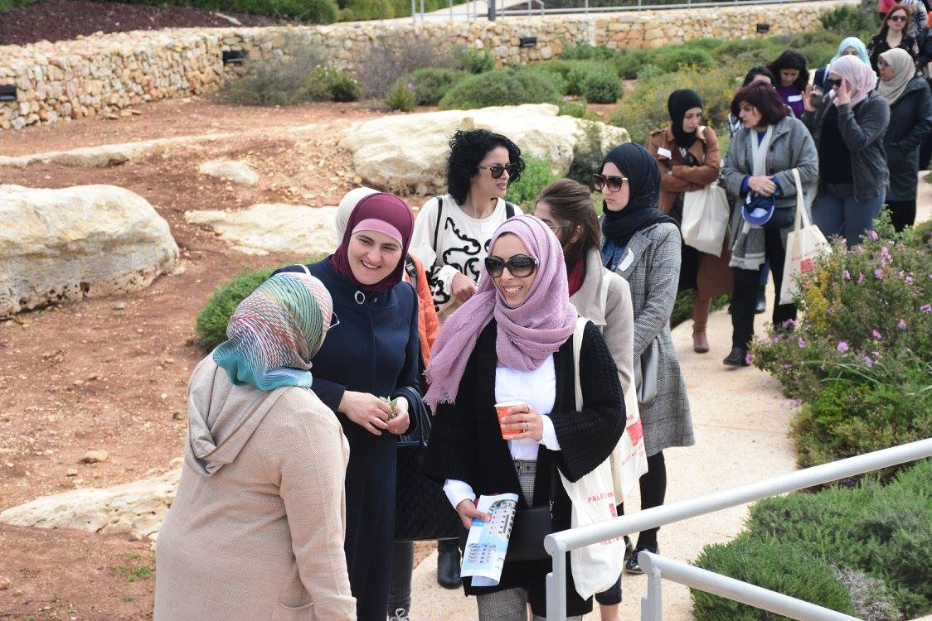
Questions?

